Slide 1
UART Follow Misra Rule

Slide 2
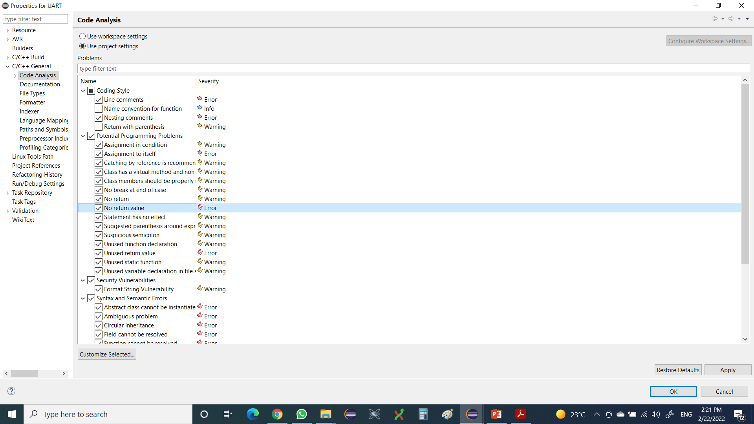
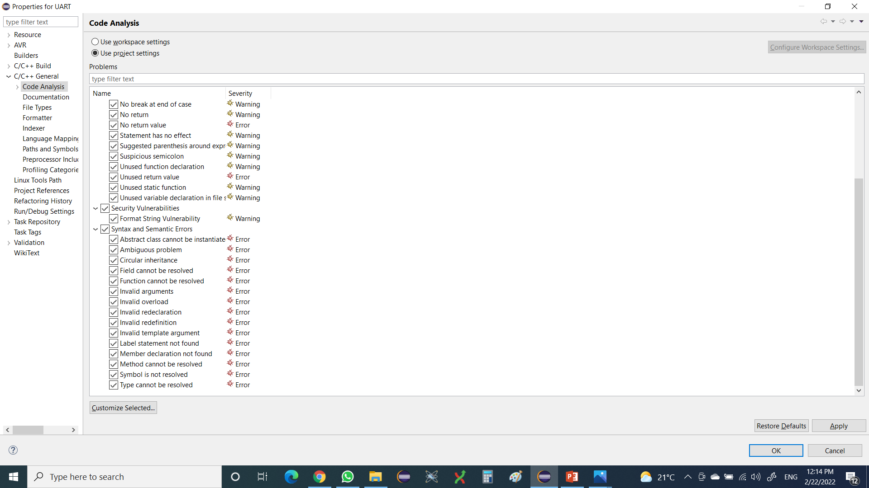
Problems:
1- If Without Else.
2- Single Comment Line.
3- Return Value From Function Once.

Slide 3
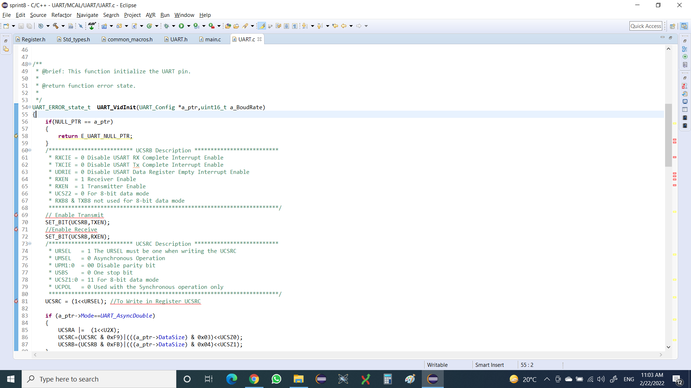
Module : UART.c No. Of Problem : 1.

Slide 4
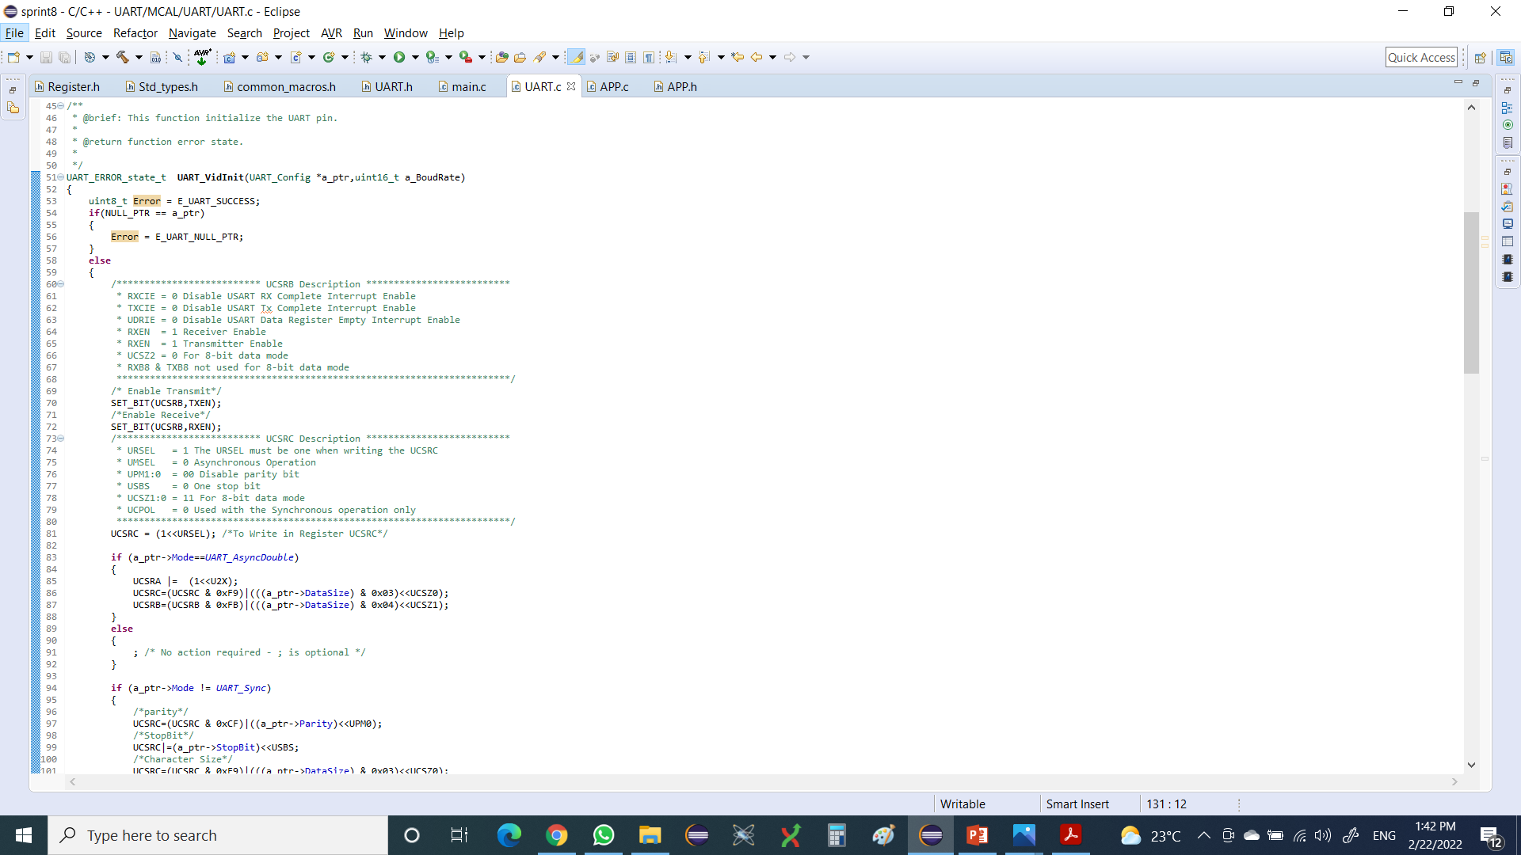
Solution.

Slide 5
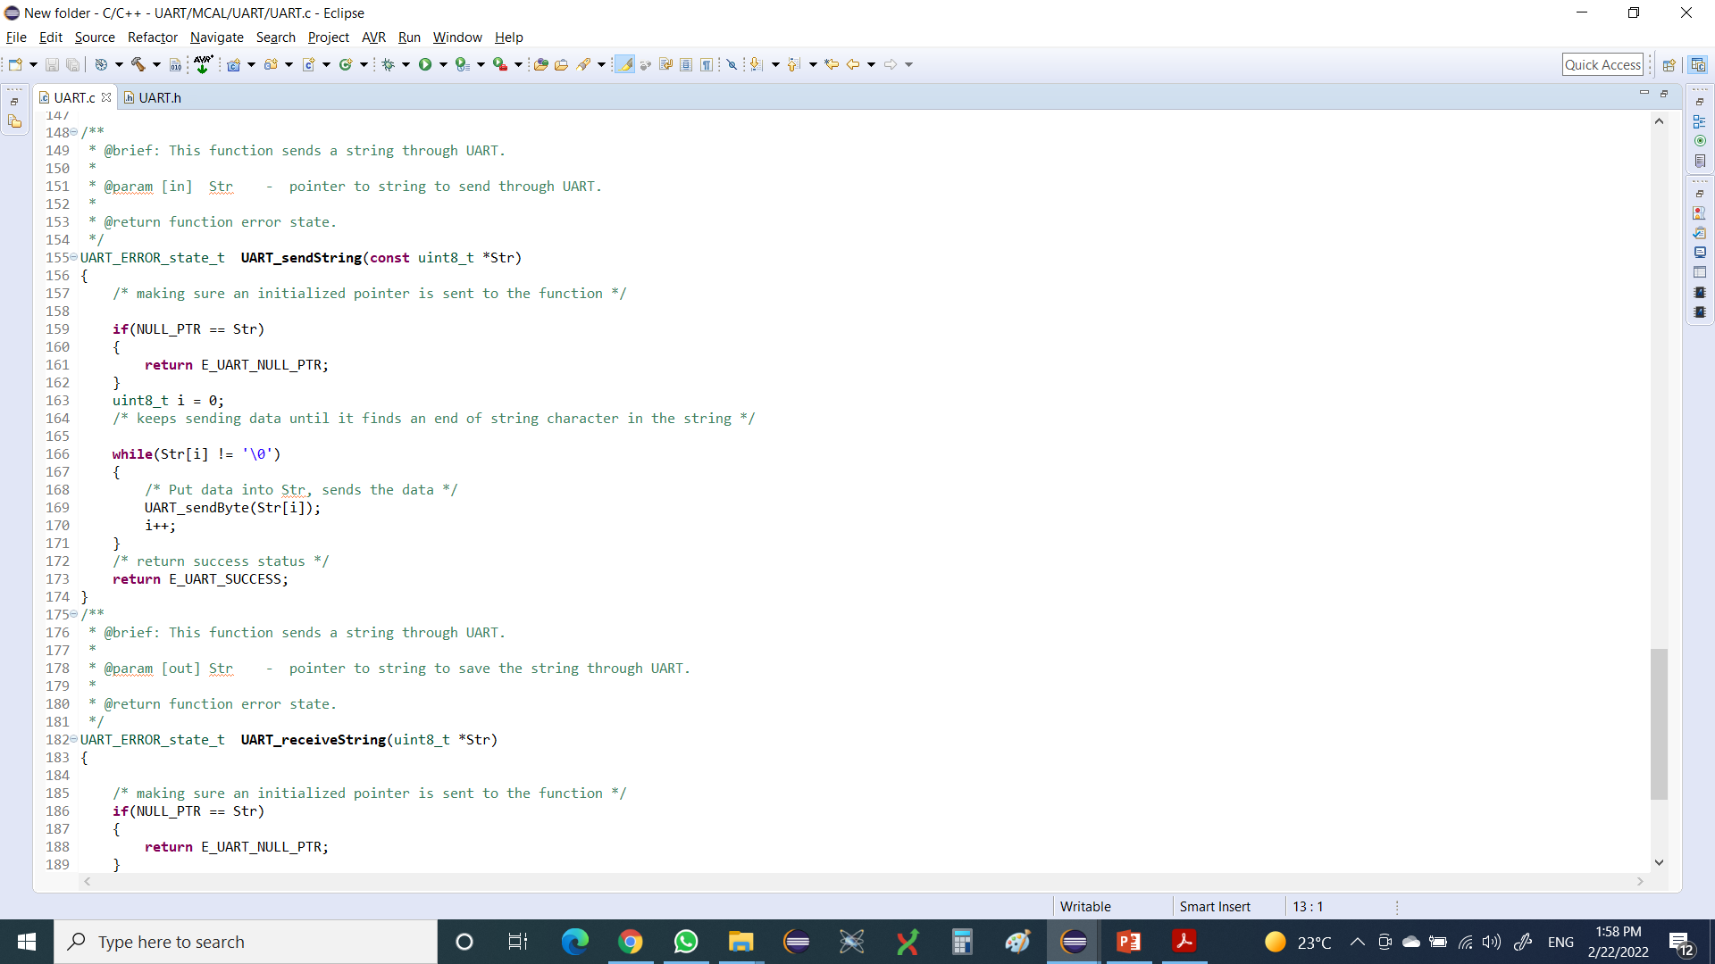
Module : UART.c No. Of Problem : 1.

Slide 6
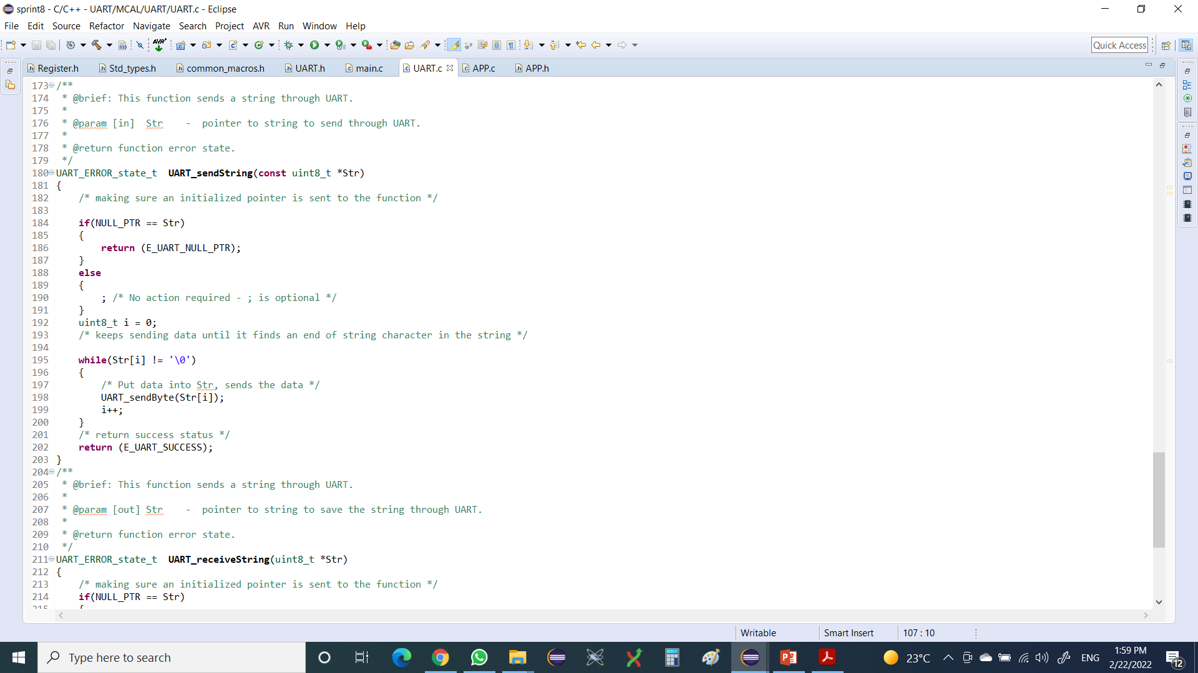
Solution.

Slide 7
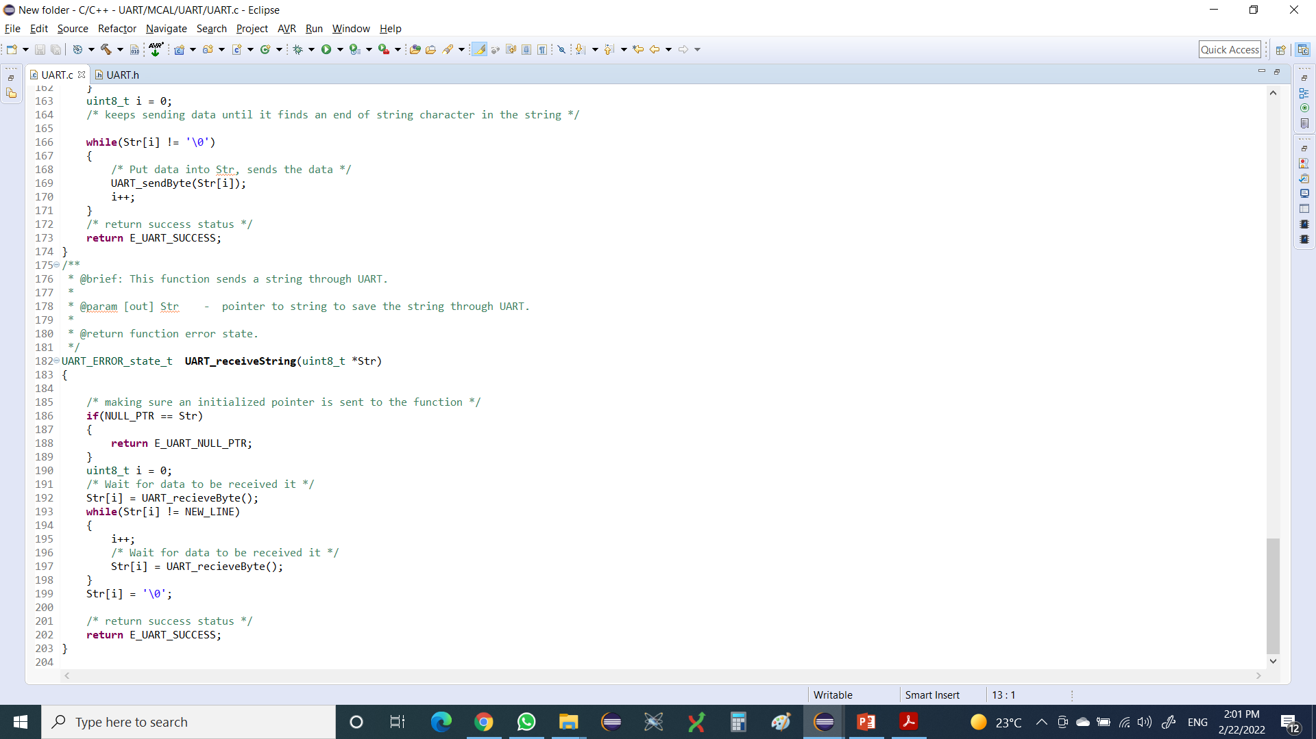
Module : UART.c No. Of Problem : 1.

Slide 8

Solution.

Slide 9
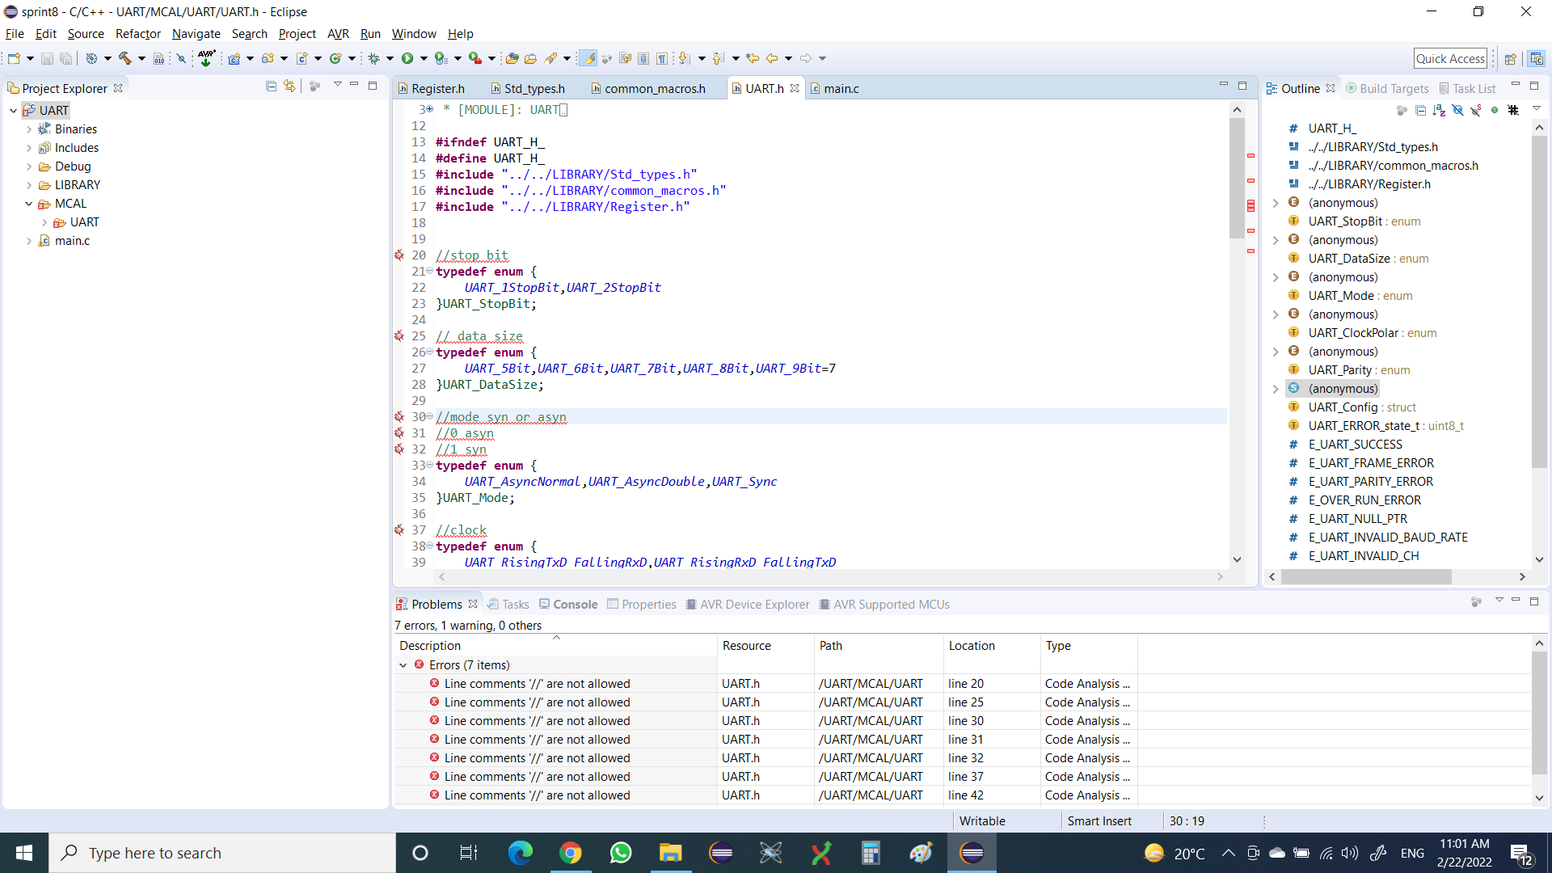
Module : UART.h No. Of Problem : 2.

Slide 10
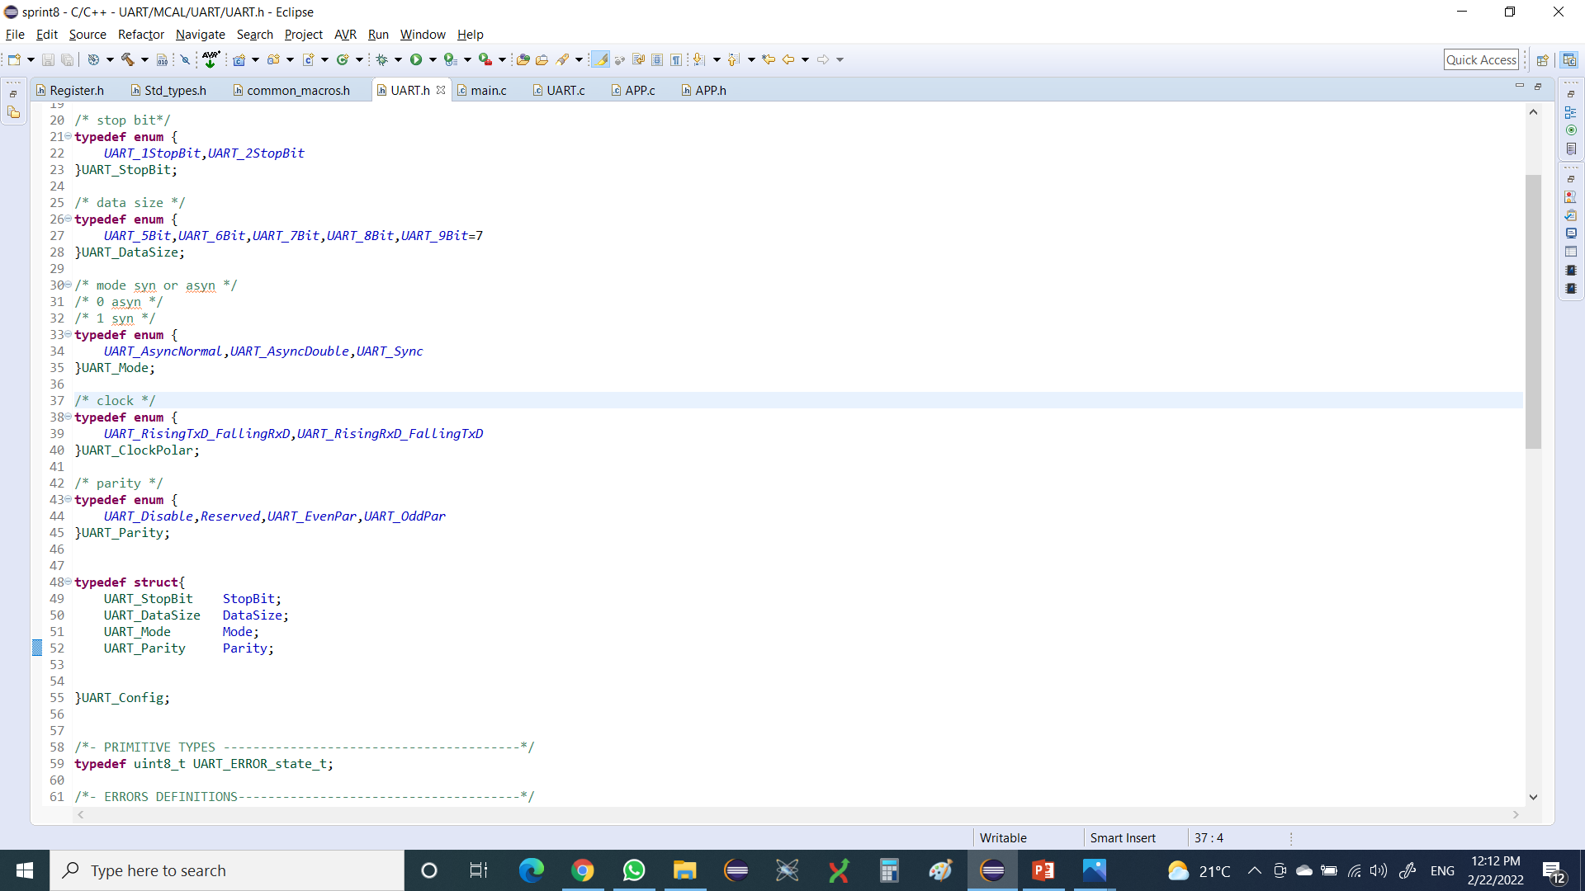
Solution.

Slide 11
Module : UART.c No. Of Problem : 2.

Slide 12
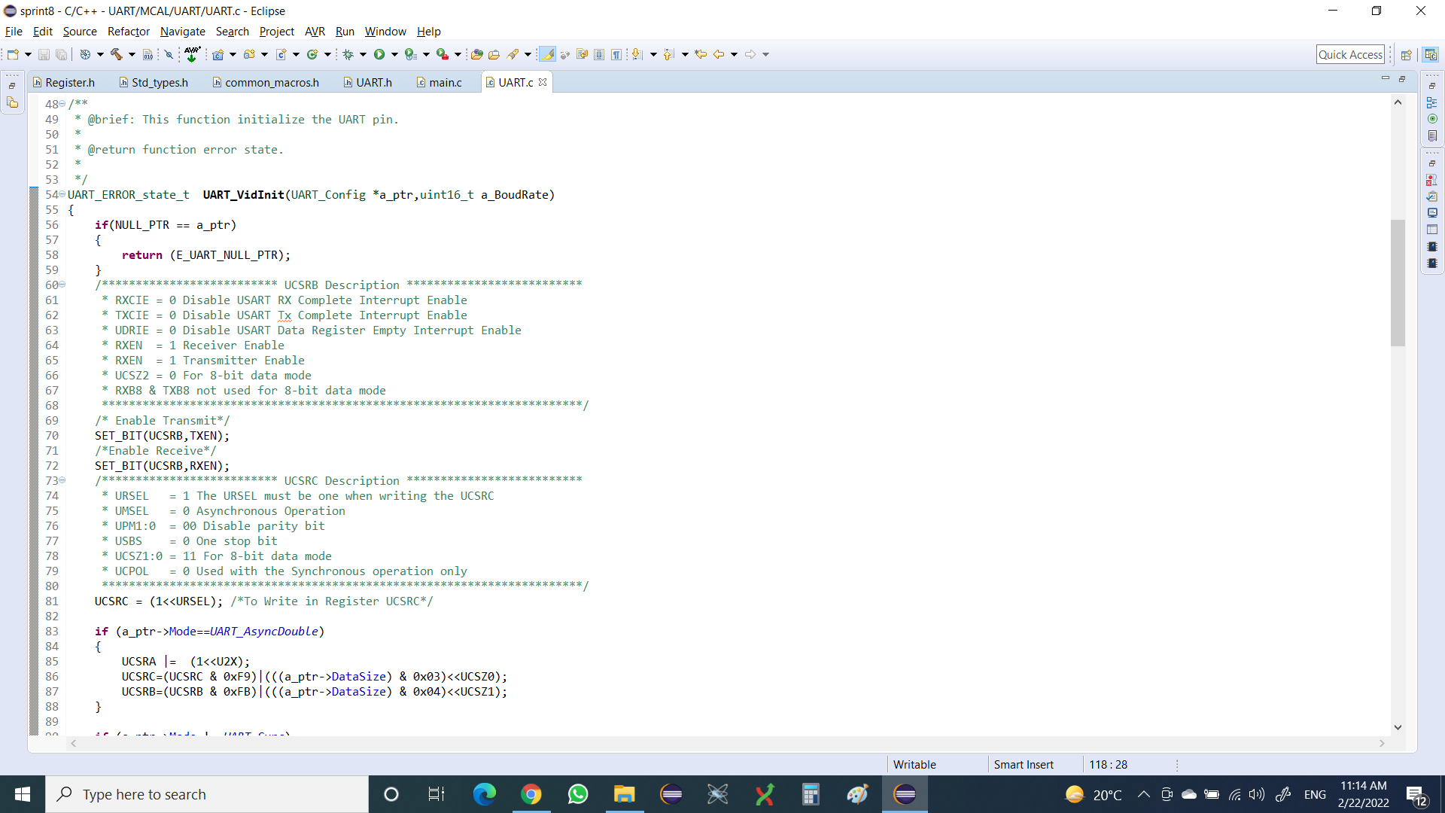
Solution.

Slide 13
Module : UART.c No. Of Problem : 3.

Slide 14
Solution.

Slide 15
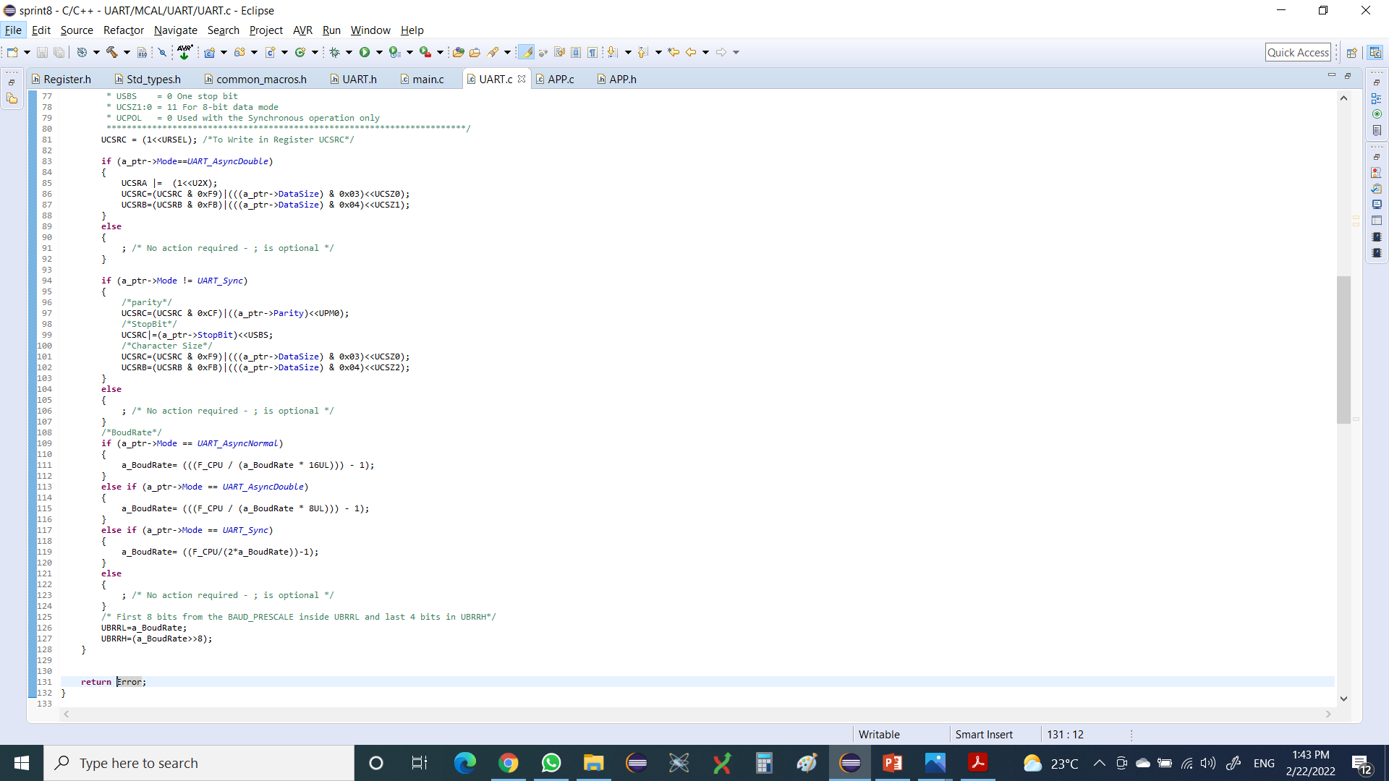
Solution.

Slide 16
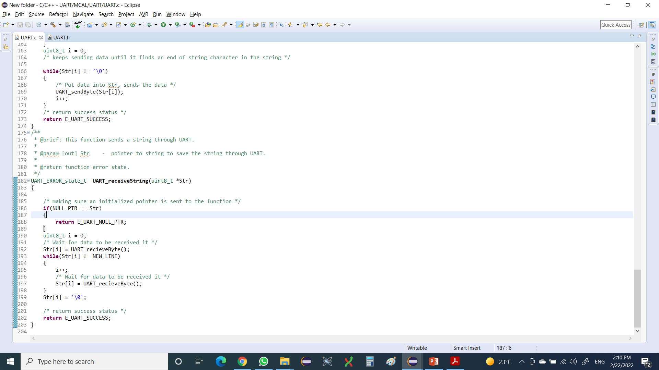
Module : UART.c No. Of Problem : 3.

Slide 17

Solution.

Slide 18

Module : UART.c No. Of Problem : 3.

Slide 19

Solution.

